Slide 1


Broadus Wood Elementary School Continuous Improvement Plan
Presented By: Dr. Kendra Core King
Date: Thursday, April 10, 2014
Notes:
Good Evening, My name is Dr. Kendra Core King and I am the principal of Broadus Wood Elementary School. Tonight, I will briefly review our school’s continuous improvement plan.

Slide 2
2013-14 Improvement Objectives
Broadus Wood student achievement will increase in reading and math through the incorporation of guided instruction, lessons focused on critical thinking, and problem/passion based learning activities.
Broadus Wood staff will focus on improving school culture and climate with school-wide Responsive Classroom practices.
Broadus Wood teachers will participate in professional learning opportunities to increase student engagement and higher thinking.
Notes:
Broadus Wood student achievement will increase in reading and math through the incorporation of guided instruction, lessons focused on critical thinking, and problem/passion based learning activities.
Broadus Wood staff will focus on improving school culture and climate by using Responsible Classroom practices.
Broadus Wood teachers will participate in professional learning opportunities to expand their knowledge of engaging students in learning and supporting their sense of belonging to the school community.

Slide 3
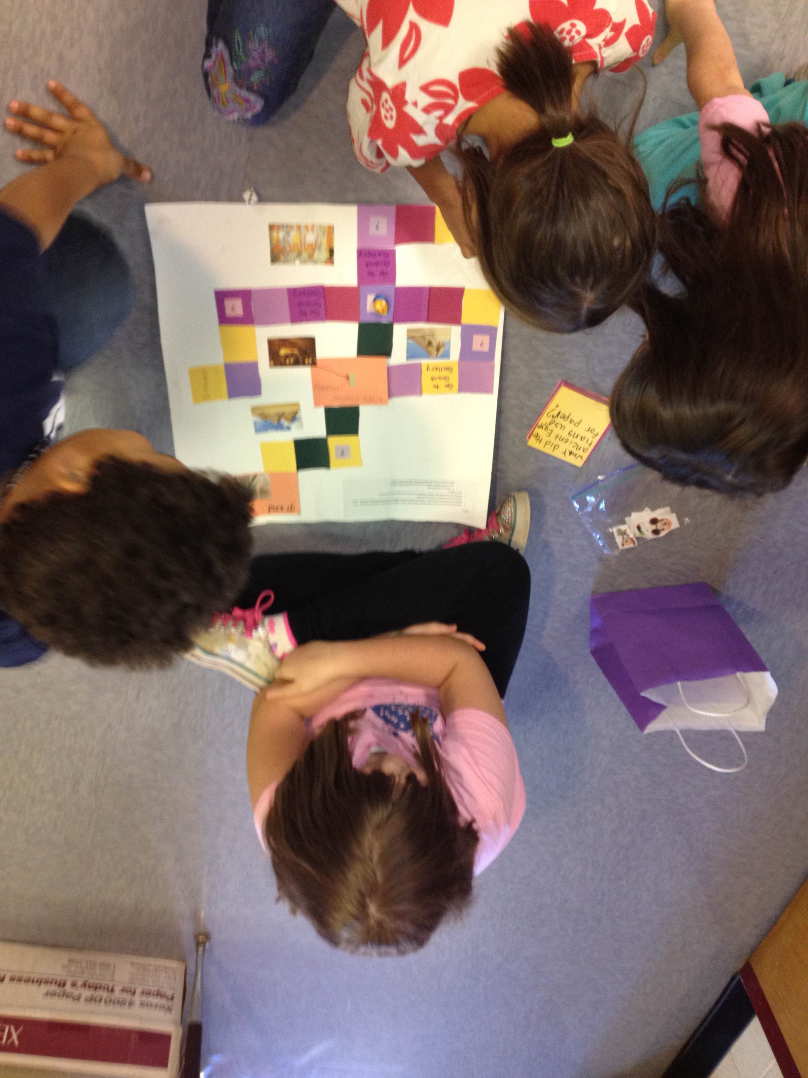
Why These Objectives are Important
Addresses the curriculum changes and learning needs of students
Supports the learning needs of teachers
Notes:
The objectives are important as they guide our work:
To address recent changes and updates to the curriculum as well as the learning needs of students.
To support the learning needs of teachers and their work to support the needs of students.

Slide 4

Current Challenges
Change
Providing adequate support for students receiving intervention
Notes:
Change is inevitable. Our school gained 11 new staff members and excluding kindergarteners, approximately 50 new students. We have had a successful school year, but the challenge will be maintaining and expanding our positive school culture.
Another challenge is with providing adequate support for students receiving intervention. Our student population has grown and staffing decisions during the previous year did not account for the percentage of students who would need services.

Slide 5
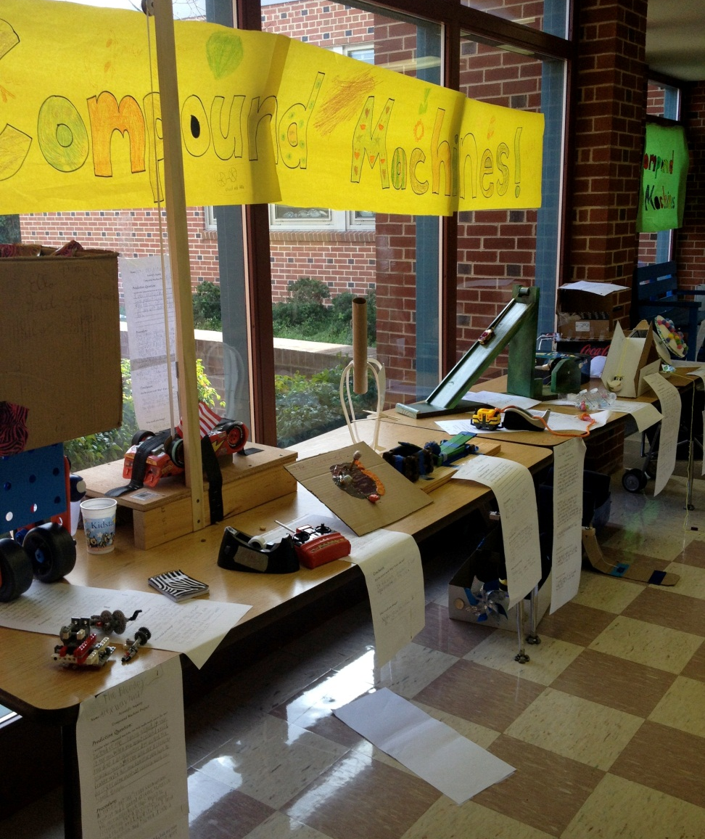
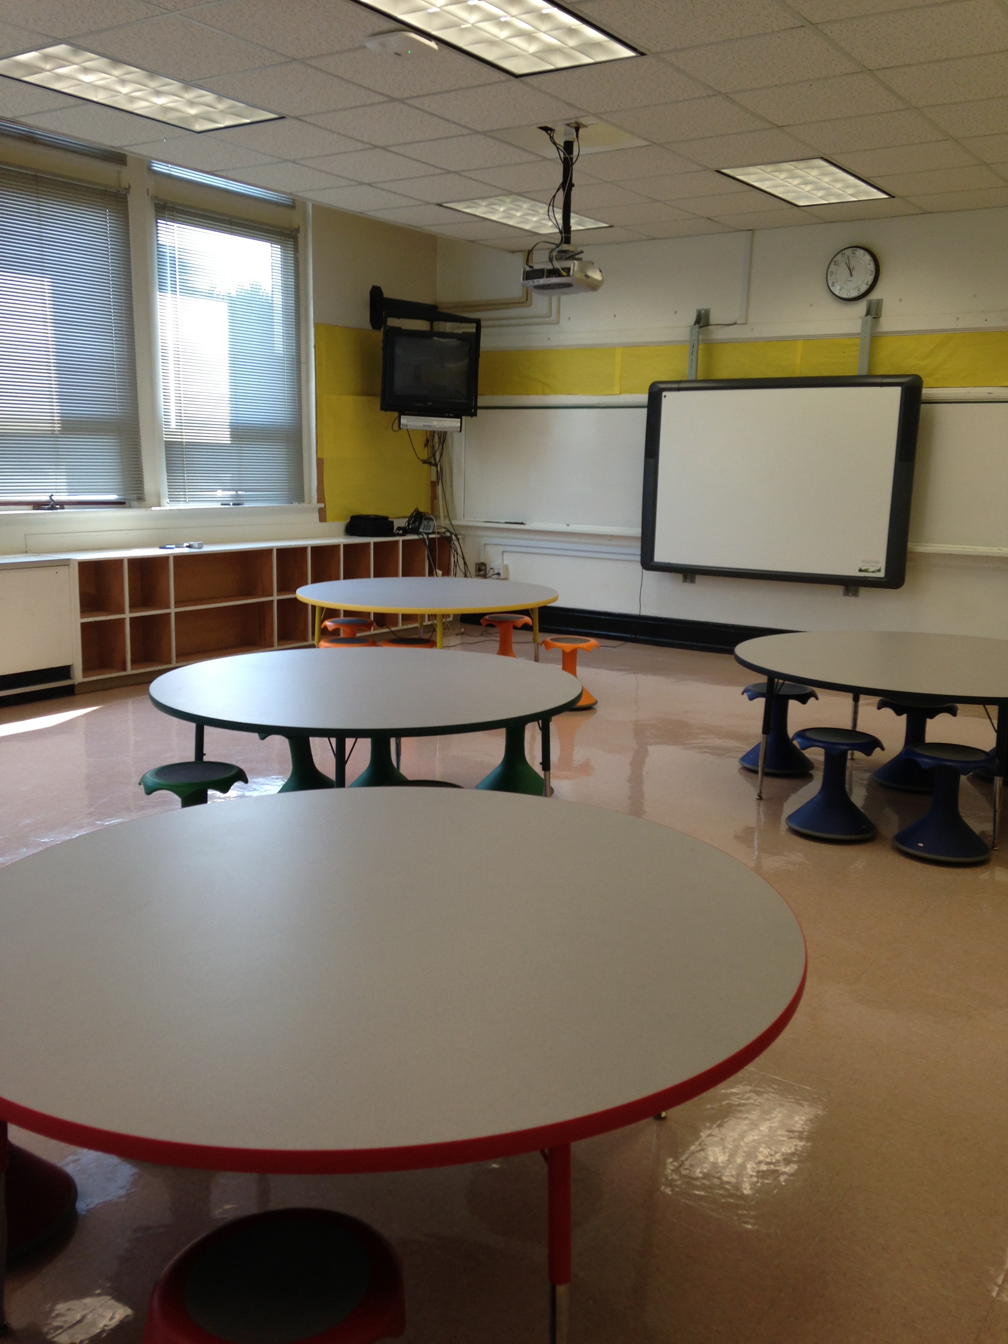
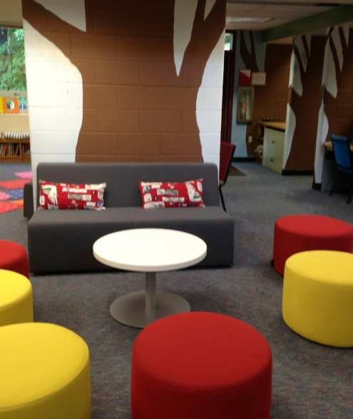
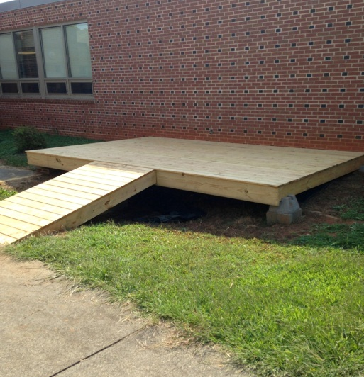
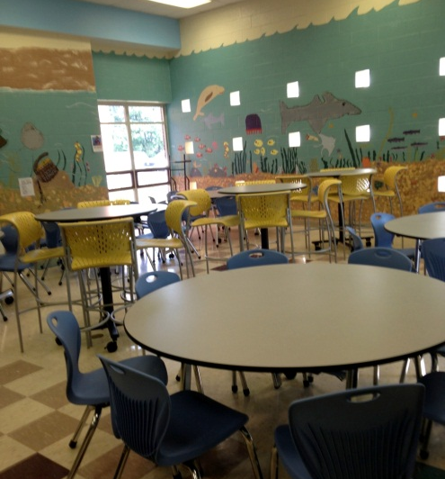
Current Successes
Notes:
Inquiry Fair: On March 26, we held our annual Inquiry Fair. Individuals, small groups, and grade levels showcased projects on topics that students “wondered” about. Topics varied from “Where does my drinking water come from?” to “How many days does it take for meat to rot?”
Learning Spaces: whole grade levels and grade level bands (K/1, 2/3, 4/5, etc.) using the transformed classroom for instruction and project work.

